Slide 1
.NET
Unit 2
2160711
The Basics and
Console Applications in C#

Slide 2
GTU Questions
1 | What is method overloading? Explain it in brief with suitable example in C#. | 7
2 | Write console based program in code behind language VB or C# to print following pattern. @ @ @ @ @ @ @ @ @ @ @ @ @ @ @ | 7
3 | Write console based program in code behind language VB or C# to print following pattern. 1 1 2 1 2 3 1 2 3 4 | 7
4 | Predict the output of the following code segment: int x = 42; int y = 12; int w; object o; o = x; w = y * (int)o; Console.WriteLine(w); | 1
5 | Can we overload the assignment operator in C#? Justify it. | 1
6 | In C#, Constructor can return the value. Justify. | 1
7 | Explain the significance of Property and Indexers with example. | 7
8 | Can you explain Constructor and Function Overloading with example? | 7
9 | Write C# code to prompt a user to input his/her name and country name and then the output will be shown as an example below: Hello Ram from country India | 4
10 | Explain the significance of Property and Indexers with example. | 7
12 | Write C# code for both the Constructor and Destructor. | 3
13 | Discuss C# Reflection API using an Example. | 4
14 | Write a C# program to demonstrate method overloading. | 4
15 | What is inheritance? Create C# console application to define Car class and derive Maruti and Mahindra from it to demonstrate inheritance. | 7
16 | Explain getter and setter method of property with suitable example. | 7

Slide 3
Whenever a class is created, its constructor is called. A class may have multiple constructors that take different arguments. Constructors enable the programmer to set default values.
Default Constructor
If we don't provide a constructor for our class, C# creates one by default that instantiates the object and sets member variables to the default values as listed in the Default Values Table.
Constructor

Slide 4
Instance Constructors
class CoOrds
{
public int x, y;
// constructor
public CoOrds()
{
x = 0;
y = 0;
}
// A constructor with two arguments:
public CoOrds(int x, int y)
{
this.x = x;
this.y = y;
}
}
Constructor
Instance constructors are used to create and initialize any instance member variables when you use the new expression to create an object of a class.

Slide 5
Private Constructors
public class Counter
{
private Counter() { }
public static int currentCount;
public static int IncrementCount()
{
return ++currentCount;
}
}
class TestCounter
{
static void Main()
{
// If you uncomment the following statement, it will generate
// an error because the constructor is inaccessible:
// Counter aCounter = new Counter(); // Error
Counter.currentCount = 100;
Counter.IncrementCount();
Console.WriteLine("New count: {0}", Counter.currentCount);
// Keep the console window open in debug mode.
Console.WriteLine("Press any key to exit.");
Console.ReadKey();
}
}
// Output: New count: 101
A private constructor is a special instance constructor.
It is generally used in classes that contain static members only.
Constructor

Slide 6
Static Constructor
A class can also have a static constructor, which initializes static members of the type.
Static constructors are parameterless.
If we don't provide a static constructor to initialize static fields, the C# compiler will supply a default static constructor that initializes static fields to their default value.
Constructor

Slide 7
Static Constructor
public class Adult : Person
{
private static int minimumAge;
public Adult(string lastName, string firstName) : base(lastName, firstName)
{ }
static Adult()
{
minimumAge = 18;
}
}
Constructor
public class Child : Person
{
private static int maximumAge;
public Child(string lastName, string firstName) : base(lastName, firstName)
{ }
static Child() => maximumAge = 18;
}

Slide 8
Copy Constructor
class Person
{
// Copy constructor.
public Person(Person previousPerson)
{
Name = previousPerson.Name;
Age = previousPerson.Age;
}
//// Alternate copy constructor calls the instance constructor.
//public Person(Person previousPerson)
// : this(previousPerson.Name, previousPerson.Age)
//{
//}
// Instance constructor.
public Person(string name, int age)
{
Name = name;
Age = age;
}
public int Age { get; set; }
public string Name { get; set; }
public string Details()
{
return Name + " is " + Age.ToString();
}
}
class TestPerson
{
static void Main()
{
//Create a Person object by using the instance constructor.
Person person1 = new Person("George", 40);
// Create another Person object, copying person1.
Person person2 = new Person(person1);
// Change each person's age.
person1.Age = 39;
person2.Age = 41;
// Change person2's name.
person2.Name = "Charles";
// Show details to verify that the name and age fields
//are distinct.
Console.WriteLine(person1.Details());
Console.WriteLine(person2.Details());
// Keep the console window open in debug mode.
Console.WriteLine("Press any key to exit.");
Console.ReadKey();
}
}
// Output:
// George is 39
// Charles is 41
Constructor

Slide 9
Finalizers (which are also called destructors) are used to perform any necessary final clean-up when a class instance is being collected by the garbage collector.
Finalizers cannot be defined in structs. They are only used with classes.
A class can only have one finalizer.
Finalizers cannot be inherited or overloaded.
Finalizers cannot be called. They are invoked automatically.
A finalizer does not take modifiers or have parameters.
Finalizers
The programmer has no control over when the finalizer is called because this is determined by the garbage collector. The garbage collector checks for objects that are no longer being used by the application. If it considers an object eligible for finalization, it calls the finalizer (if any) and reclaims the memory used to store the object.

Slide 10
Types of Inheritance
Implementation Inheritance
Interface Inheritance
Inheritance

Slide 11
Types of Inheritance
Implementation Inheritance
Type derived from base class, taking all the base type’s member fields and functions.
A derived type adopts the base type’s implementation of each function (unless it is indicated in the definition of the derived type that a function implementation is to be overridden)
Useful when we need to add functionality to an existing type
Inheritance

Slide 12
Types of Inheritance
Interface Inheritance
A type inherits only the signatures of the functions and does not inherit any implementation.
Useful when we want to specify that a type makes certain features available.
Inheritance

Slide 13
Types of Inheritance
Multiple Inheritance
c# does not support multiple implementation inheritance, however, allows types to derived from multiple interface.
Inheritance

Slide 14
Types of Inheritance
Structs and Classes
Struct do not support interface, beyond the fact that every struct is automatically derived from System.ValueType.
Struct don’t support implementation inheritance, but they do support interface inheritance
Structs: always derived from System.ValueType. They can also be derived from any number of interfaces.
Classes: always derived from one other class of your choosing. They can also be derived from any number of interfaces.
Inheritance

Slide 15
Implementation Inheritance
To declare that a class derives from another class, use the following syntax:
class MyDerivedClass : MyBaseClass
{ // functions and data members here }
Inheritance

Slide 16
Implementation Inheritance
If a class also derives from interfaces, then the list of base class and interfaces is separated by commas:
class MyDerivedClass : MyBaseClass, Interface1, Interface2
{ // functions and data members here }
Inheritance

Slide 17
Virtual Methods
By declaring a base class function as virtual, we allow the function to be overridden in any derived classes:
class MyBaseClass
{
public virtual string VirtualMethod()
{
return “This method is virtual and defined in MyBaseClass”
}
}
Inheritance

Slide 18
Virtual Methods
By declaring a base class function as virtual, we allow the function to be overridden in any derived classes:
class MyDerivedClass : MyBaseClass
{
public override string VirtualMethod()
{
return “This method is an override defined in MyDerivedClass”
}
}
Inheritance

Slide 19
Calling Base Versions of Functions
if we want a method in a derived class to return 90 percent of the value returned by the base class method, you can use the following syntax:
class CustomerAccount {
public virtual decimal CalculatePrice() {
// implementation
return 0.0M;
}
} class GoldAccount : CustomerAccount {
public override decimal CalculatePrice() {
return base.CalculatePrice() * 0.9M;
}
}
Inheritance

Slide 20
Abstract Classes and Functions
C# allows both classes and functions to be declared as abstract.
An abstract class cannot be instantiated.
An abstract function does not have an implementation, and must be overridden in any non- abstract derived class.(an abstract function is automatically virtual)
Inheritance
abstract class Building
{
public abstract decimal CalculateHeatingCost();
// abstract method
}

Slide 21
Sealed Classes and Methods
C# allows classes and methods to be declared as sealed.
In the case of a class, this means that you can’t inherit from that class.
In the case of a method, this means that you can’t override that method.
Inheritance
sealed class FinalClass
{
// etc
}
class DerivedClass : FinalClass //will give error
{
// etc
}

Slide 22
Constructor of Derived Classes
Inheritance

Slide 23
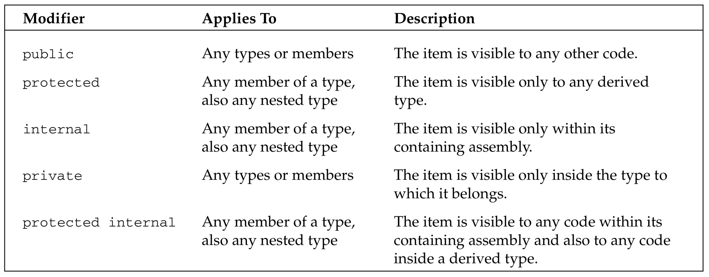
Visibility Modifiers
These modifiers indicate which other code items can view an item.
Modifiers

Slide 24
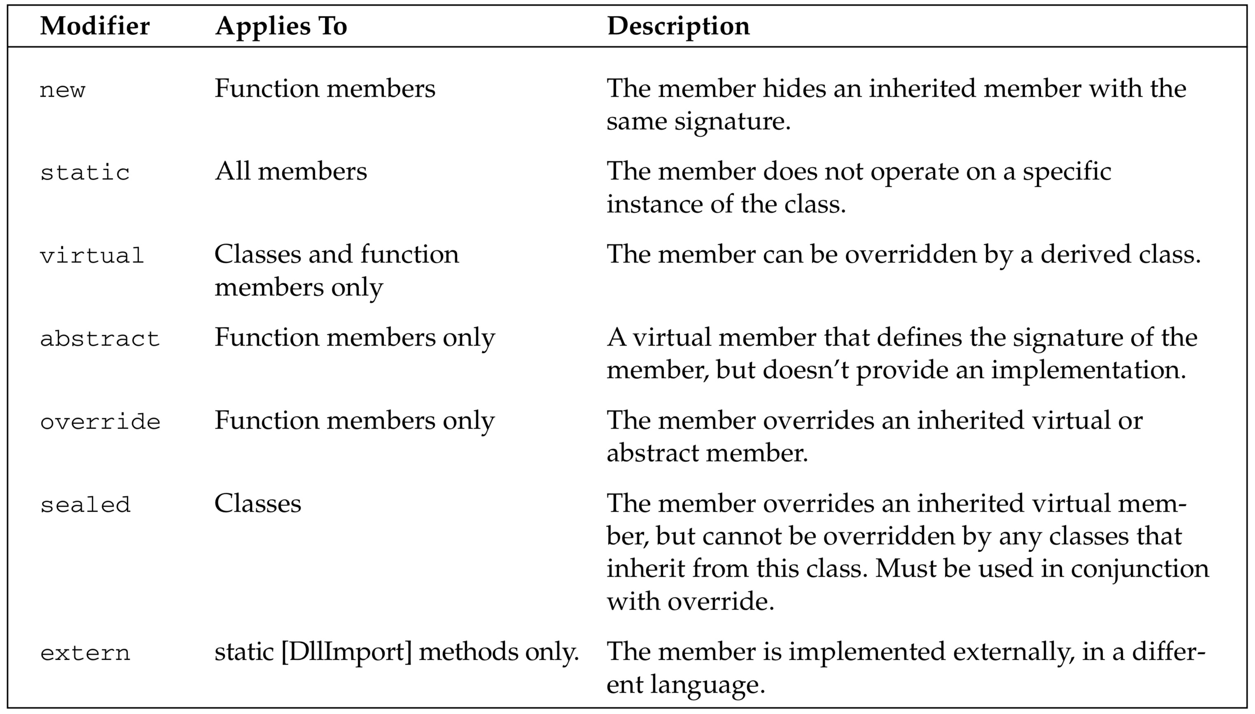
Other Modifiers
These modifiers indicate which other code items can view an item.
Modifiers

Slide 25
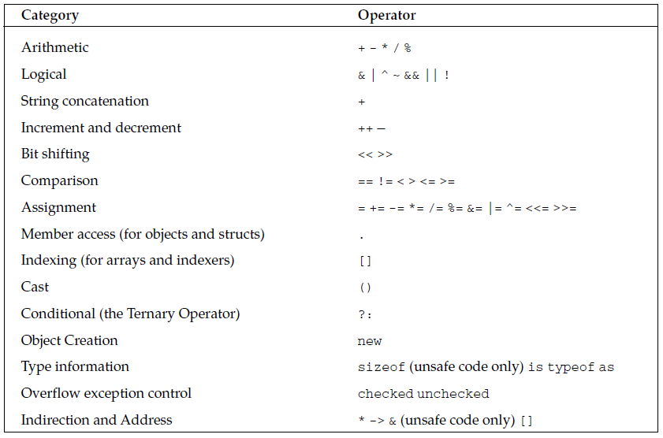
Operators

Slide 26
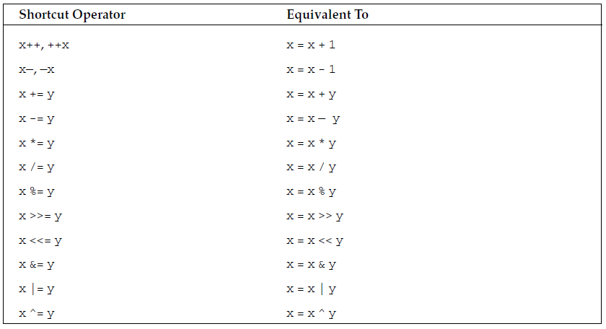
Operators Shortcuts

Slide 27
Operators Shortcuts
int x = 5;
if (++x == 6)
{
Console.WriteLine(“This will execute”);
}
if (x++ == 7)
{
Console.WriteLine(“This won’t”);
}

Slide 28
The Ternary Operator
condition ? true_value : false_value

Slide 29
The Ternary Operator
condition ? true_value : false_value
int x = 1;
string s = x.ToString() + “ “;
s += (x == 1 ? “man” : “men”);
Console.WriteLine(s);

Slide 30
The checked and unchecked Operators
byte b = 255;
b++;
Console.WriteLine(b.ToString());
byte b = 255;
checked
{
b++;
}
Console.WriteLine(b.ToString());
byte b = 255;
unchecked
{
b++;
}
Console.WriteLine(b.ToString());

Slide 31
The is Operator
The is operator allows us to check whether an object is compatible with a specific type.
int i = 10;
if (i is object)
{
Console.WriteLine(“i is an object”);
}

Slide 32
The as Operator
The is operator allows us to check whether an object is compatible with a specific type.
object o1 = “Some String”;
object o2 = 5;
string s1 = o1 as string; // s1 = “Some String”
string s2 = o2 as string; // s2 = null

Slide 33
The typeof Operator
The typeof operator returns a System.Type object representing a specified type. For example, typeof(string) will return a Type object representing the System.String type.
This is useful when we want to use reflection to find out information about an object dynamically.

Slide 34
Type Safety
Type Conversions
Implicit conversions
explicit conversions

Slide 35
Type Safety
Type Conversions
Implicit conversions
int value1 = 10;
int value2 = 23;
byte total;
total = value1 + value2; //Cannot implicitly convert type ‘int’ to ‘byte’
Console.WriteLine(total);

Slide 36
Type Safety
Type Conversions
Implicit conversions
int value1 = 10;
int value2 = 23;
long total;
total = value1 + value2; //Cannot implicitly convert type ‘int’ to ‘byte’
Console.WriteLine(total);

Slide 37
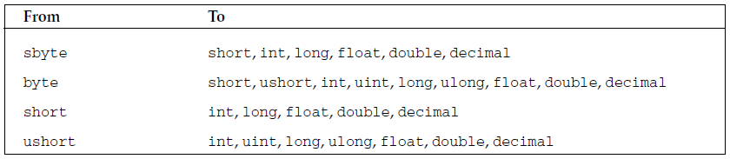
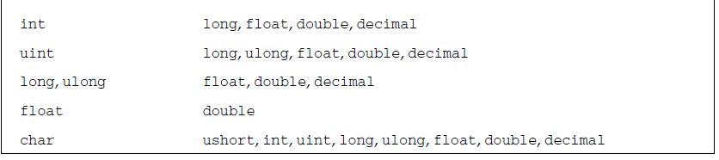
Type Safety
Type Conversions
Implicit conversions

Slide 38
Type Safety
Type Conversions
explicit conversions
❑ int to short—May lose data
❑ int to uint—May lose data
❑ uint to int—May lose data
❑ float to int—Will lose everything after the decimal point
long val = 30000;
int i = (int)val; // A valid cast. The maximum int is 2147483647

Slide 39
Type Safety
Type Conversions
explicit conversions
❑ int to short—May lose data
❑ int to uint—May lose data
❑ uint to int—May lose data
❑ float to int—Will lose everything after the decimal point
long val = 3000000000;
int i = (int)val; // An invalid cast. The maximum int is 2147483647
-1294967296

Slide 40
Type Safety
Type Conversions
explicit conversions
❑ int to short—May lose data
❑ int to uint—May lose data
❑ uint to int—May lose data
❑ float to int—Will lose everything after the decimal point
long val = 3000000000;
int i = checked ((int)val); // An invalid cast. The maximum int is 2147483647

Slide 41
Type Safety
Boxing and Unboxing
Boxing
int i = 20;
object o = i; // Box the int
int j = (int)o; // Unbox it back into an int
Boxing and its counterpart, unboxing, allow us to convert value types to reference types and then back to value types
Boxing is the term used to describe the transformation of a value type to a reference type
Unboxing is the term used to describe the reverse process, where the value of a previously boxed value type is cast back to a value type

Slide 42
Operator Overloading
The point of operator overloading is that you don’t always just want to call methods or properties on class instances.
Often you need to do things like adding quantities together, multiplying them, or performing logical operations such as comparing objects.
Now in the world of math, matrices can be added together and multiplied, just like numbers.
Matrix a, b, c;
// assume a, b and c have been initialized
Matrix d = c * (a + b);
The result would certainly be less intuitive, and would probably look something like this:
Matrix d = c.Multiply(a.Add(b));

Slide 43
Operator Overloading
The other thing we should stress is that overloading isn’t just concerned with arithmetic operators. We also need to consider the comparison operators, ==, <, >, !=, >=, and <=.
Take the statement if (a==b). For classes, this statement will, by default, compare the references a and b — it tests to see if the references point to the same location in memory, rather than checking to see if the instances actually contain the same data.

Slide 44
Operator Overloading
There are a large number of situations in which being able to overload operators will allow us to generate more readable and intuitive code, including:
Almost any mathematical object such as coordinates, vectors, matrices, tensors, functions, and so on. If you are writing a program that does some mathematical or physical modeling, you will almost certainly use classes representing these objects.
Graphics programs that use mathematical or coordinate-related objects when calculating positions on screen.
A class that represents an amount of money (for example, in a financial program).
A word processing or text analysis program that uses classes representing sentences, clauses and so on; you might want to use operators to combine sentences (a more sophisticated version of concatenation for strings).

Slide 45
Operator Overloading
public static Vector operator +(Vector lhs, Vector rhs)
{
Vector result = new Vector(lhs);
result.x += rhs.x;
result.y += rhs.y;
result.z += rhs.z;
return result;
}
public double x, y, z;
public Vector(double x, double y, double z)
{
this.x = x;
this.y = y;
this.z = z;
}
public Vector(Vector rhs)
{
x = rhs.x;
y = rhs.y;
z = rhs.z;
}
public override string ToString()
{
return "( " +x + " , " +y + " , " +z + " )";
}

Slide 46
Operator Overloading
static void Main()
{
Vector vect1, vect2, vect3;
vect1 = new Vector(3.0, 3.0, 1.0);
vect2 = new Vector(2.0, -4.0, -4.0);
vect3 = vect1 + vect2;
Console.WriteLine("vect1 = " +vect1.ToString());
Console.WriteLine("vect2 = " +vect2.ToString());
Console.WriteLine("vect3 = " +vect3.ToString());
}
Output:
vect1 = ( 3 , 3 , 1 )
vect2 = ( 2 , -4 , -4 )
vect3 = ( 5 , -1 , -3 )

Slide 47
Property and Indexer
Property | Indexer
Allows methods to be called as if they were public data members. | Allows elements of an internal collection of an object to be accessed by using array notation on the object itself.
Accessed through a simple name. | Accessed through an index.
Can be a static or an instance member. | Must be an instance member.
A get accessor of a property has no parameters. | A get accessor of an indexer has the same formal parameter list as the indexer.
A set accessor of a property contains the implicit value parameter. | A set accessor of an indexer has the same formal parameter list as the indexer, and also to the value parameter.
Supports shortened syntax with Auto-Implemented Properties. | Does not support shortened syntax.

Slide 48
Property
// Declare a Name property of type string:
public string Name
{
get
{
return name;
}
set
{
name = value;
}
}
// Declare a Age property of type int:
public int Age
{
get
{
return age;
}
set
{
age = value;
}
}
public override string ToString()
{
return "Code = " + Code + ", Name = " + Name + ", Age = " + Age;
}
}
class Student
{
private string code = "N.A";
private string name = "not known";
private int age = 0;
// Declare a Code property of type string:
public string Code
{
get
{
return code;
}
set
{
code = value;
}
}

Slide 49
Property
class ExampleDemo
{
public static void Main()
{
// Create a new Student object:
Student s = new Student();
// Setting code, name and the age of the student
s.Code = "001";
s.Name = "Zara";
s.Age = 9;
Console.WriteLine("Student Info: {0}", s);
//let us increase age
s.Age += 1;
Console.WriteLine("Student Info: {0}", s);
Console.ReadKey();
}
}

Slide 50
Indexer
using System;
using System.Collections.Generic;
using System.Text;
namespace Indexers
{
class ParentClass
{
private string[] range = new string[5];
public string this[int indexrange]
{
get
{
return range[indexrange];
}
set
{
range[indexrange] = value;
}
}
}
class childclass
{
public static void Main()
{
ParentClass obj = new ParentClass();
obj[0] = "ONE";
obj[1] = "TWO";
obj[2] = "THREE";
obj[3] = "FOUR ";
obj[4] = "FIVE";
Console.WriteLine("WELCOME TO C# CORNER HOME PAGE\n");
Console.WriteLine("\n");
Console.WriteLine("{0}\n,{1}\n,{2}\n,{3}\n,{4}\n", obj[0], obj[1], obj[2], obj[3], obj[4]);
}
}
}

Slide 51
Indexer
using System;
using System.Collections.Generic;
using System.Text;
namespace Indexers
{
class ParentClass
{
private string[] range = new string[5];
public string this[int indexrange]
{
get
{
return range[indexrange];
}
set
{
range[indexrange] = value;
}
}
}
class childclass
{
public static void Main()
{
ParentClass obj = new ParentClass();
obj[0] = "ONE";
obj[1] = "TWO";
obj[2] = "THREE";
obj[3] = "FOUR ";
obj[4] = "FIVE";
Console.WriteLine("WELCOME TO C# CORNER HOME PAGE\n");
Console.WriteLine("\n");
Console.WriteLine("{0}\n,{1}\n,{2}\n,{3}\n,{4}\n", obj[0], obj[1], obj[2], obj[3], obj[4]);
}
}
}

Slide 52
Delegates
A delegate is a type that represents references to
methods with a particular parameter list and return type.
When you instantiate a delegate, you can associate its instance with any method with a compatible signature and return type.
public delegate int PerformCalculation(int x, int y);
In the context of method overloading, the signature of a method does not include the return value.
But in the context of delegates, the signature does include the return value. In other words, a method must have the same return type as the delegate.

Slide 53
Delegates
using System;
class Program
{
// declare delegate
public delegate void Print(int value);
static void Main(string[] args)
{
Print printDel = PrintAdd;
printDel(200);
printDel = PrintSquare;
printDel(200);
}
public static void PrintAdd(int num)
{
Console.WriteLine("Number: {0}", num+99);
}
public static void PrintSquare(int num)
{
Console.WriteLine("Money: {0}", num * num);
}
}

Slide 54
Events
Events are user actions such as key press, clicks, mouse movements, etc., or some occurrence such as system generated notifications.
Event and delegate are linked together.
Event is a reference of delegate i.e. when event will be raised delegate will be called.
Events are nothing but change of state. Events play an important part in GUI programming. Events and delegates work hand-in-hand to provide a program's functionality.

Slide 55
Events
Publisher class
Subscriber class
The class containing the event is used to publish the event. This is called the publisher class.
A publisher is an object that contains the definition of the event and the delegate.
A publisher class object invokes the event and it is notified to other objects
Some other class that accepts this event is called the subscriber class.
A subscriber is an object that accepts the event and provides an event handler.
The delegate in the publisher class invokes the method (event handler) of the subscriber class

Slide 56
Events
Events can be declared in two ways.
The first is with explicit add and remove methods, declared in a very similar way to properties, but with the event keyword.
using System;
class Test
{
public event EventHandler MyEvent
{
add
{
Console.WriteLine("add operation");
}
remove
{
Console.WriteLine("remove operation");
}
}
static void Main()
{
Test t = new Test();
t.MyEvent += new EventHandler(t.DoNothing);
t.MyEvent -= null;
}
void DoNothing(object sender, EventArgs e)
{
}
}

Slide 57
Events
using System;
namespace delegate_custom
{
public delegate void MyDelegate(int a);
public class XX
{
public event MyDelegate MyEvent;
public void RaiseEvent()
{
MyEvent(20);
Console.WriteLine("Event Raised");
}
public void Display(int x)
{
Console.WriteLine("Display Method {0}", x);
}
}
class Program
{
static void Main(string[] args)
{
XX obj = new XX();
obj.MyEvent += new MyDelegate(obj.Display);
obj.RaiseEvent();
Console.ReadLine();
}
}
}

Slide 58
Events
namespace SampleApp
{
public delegate string MyDel(string str);
class EventProgram
{
event MyDel MyEvent;
public EventProgram()
{
this.MyEvent += new MyDel(this.WelcomeUser);
}
public string WelcomeUser(string username)
{
return "Welcome " + username;
}
static void Main(string[] args)
{
EventProgram obj1 = new EventProgram();
string result = obj1.MyEvent(“Event");
Console.WriteLine(result);
}
}
}

Slide 59
Reflection
What is it?
An ability of inspecting an assembly's metadata at runtime
It is used to find all information in an assembly
type,
properties,
constructors,
methods, and
events
Ref. http://csharp-video-tutorials.blogspot.com/2012/07/part-53-c-tutorial-reflection.html

Slide 60
Reflection
Use of Reflection API
By IDE or a UI designers
To dynamically create an instance of a type, about which we don't have any information at compile time. (late binding)
Ref. http://csharp-video-tutorials.blogspot.com/2012/07/part-53-c-tutorial-reflection.html

Slide 61
Reflection
Example 1
class Customer
{
public int ID { get; set; }
public string Name { get; set; }
public Customer(int ID, string Name)
{
this.ID = ID;
this.Name = Name;
}
public Customer()
{
this.ID = -1;
this.Name = string.Empty;
}
public void printID()
{
Console.WriteLine("ID is: {0}", this.ID);
}
public void printName()
{
Console.WriteLine("Name is: {0}", this.Name);
}
}
Ref. http://csharp-video-tutorials.blogspot.com/2012/07/part-53-c-tutorial-reflection.html

Slide 62
Reflection
Example 1
class MainClass
{
static void Main()
{
Type T = Type.GetType("ReflectionExample.Customer");
MethodInfo[] methods = T.GetMethods();
foreach (MethodInfo method in methods){
Console.WriteLine(method.ReturnType + " " + method.Name);
}
PropertyInfo[] properties = T.GetProperties();
Console.WriteLine("\nProperties");
foreach (PropertyInfo property in properties){
Console.WriteLine(property.PropertyType+" "+ property.Name);
}
Console.WriteLine("\nConstructors");
ConstructorInfo[] constructors = T.GetConstructors();
foreach (ConstructorInfo constructor in constructors){
Console.WriteLine(constructor.ToString());
}
}
}
Ref. http://csharp-video-tutorials.blogspot.com/2012/07/part-53-c-tutorial-reflection.html

Slide 63
In C#, Constructor can return the value. Justify.

Slide 64
In C#, Constructor can return the value. Justify.
Syntax of Constructor:
modifier className (dataType parameter1, dataType parameterN) {
//initializations of class fields
}

Slide 65
In C#, Constructor can return the value. Justify.
Syntax of Constructor:
modifier className (dataType parameter1, dataType parameterN) {
//initializations of class fields
}
Constructors do not have a return type

Slide 66
In C#, Constructor can return the value. Justify.
Example 1 of Constructor:
public Scores(string studentName, int examMark)
{
name = studentName;
score = examMark;
}

Slide 67
In C#, Constructor can return the value. Justify.
Example 2 of Constructor:
Constructors do not have a return type,
but we can use pass by reference to achieve similar effect.
public class ClassA
{
public ClassA(out bool success)
{
success = true;
}
}
https://stackoverflow.com/questions/13497626/how-to-return-a-value-using-constructor-in-c

Slide 68
Write C# code for both the Constructor and Destructor.

Slide 69
Write C# code for both the Constructor and Destructor.
Destructors are used to destruct instances of classes.
In C# you can never call them,
the reason is one cannot destroy an object.
it's the Garbage Collector (GC), who calls the destructor.
https://www.c-sharpcorner.com/UploadFile/72d20e/concept-of-destructor-in-C-Sharp/

Slide 70
Write C# code for both the Constructor and Destructor.
class First
{
~First()
{
System.Console.WriteLine("First's destructor is called");
}
}
class Second : First
{
~Second()
{
System.Console.WriteLine("Second's destructor is called");
}
}
class Third : Second
{
~Third()
{
System.Console.WriteLine("Third's destructor is called");
}
}
class TestDestructors
{
static void Main()
{
Third t = new Third();
}
}
https://www.c-sharpcorner.com/UploadFile/72d20e/concept-of-destructor-in-C-Sharp/

Slide 71
Write C# code for both the Constructor and Destructor.
Characteristics of Destructor
Destructors cannot be defined in Structs (only used with classes).
Destructor cannot be inherited or overloaded.
Destructor does not take modifiers or have parameters.
Destructor cannot be called. They are invoked automatically.
An instance becomes eligible for destruction when it is no longer possible for any code to use the instance.
The Programmer has no control over when destructor is called because this is determined by Garbage Collector.
Destructor is called when program exits.
Execution of the destructor for the instance may occur at any time after the instance becomes eligible for destruction.
https://www.c-sharpcorner.com/UploadFile/72d20e/concept-of-destructor-in-C-Sharp/

Slide 72
Constructor and Function Overloading with example.

Slide 73
Constructor and Function Overloading with example.
Constructor overloading
=
constructors with different set of parameters
class PassByRef
{
public PassByRef(int val)
public PassByRef(out int val)
public PassByRef(string message)
public PassByRef()
}
//This code snippet is just representation of concept.

Slide 74
Constructor and Function Overloading with example.
Function overloading
=
functions with different set of parameters
class overloadingExample
{
public int Add(int a)
public int Add(out int a)
public int Add(int a, int b)
public string Add(int a, int b, string msg)
}
//This code snippet is just representation of concept.

Slide 75
Can we overload the assignment operator in C#? Justify it.

Slide 76
Can we overload the assignment operator in C#? Justify it.
You can overload operations that
are applied to the objects,
but not to reference
https://stackoverflow.com/questions/599367/why-can-not-be-overloaded-in-c/599389

Slide 77
Can we overload the assignment operator in C#? Justify it.
When we define a class and its members we are defining the object behavior, but when we create a variable we are working with references to those objects.
Now, the operator = is applied to references, not objects. When you assign a reference to another you are actually making the receiving reference point to the same object that the other reference is.
Type var1 = new Type();
Type var2 = new Type();
var2 = var1;
https://stackoverflow.com/questions/599367/why-can-not-be-overloaded-in-c/599389

Slide 78
Write console based program in code behind language VB or C# to print following pattern.
@ @ @ @ @
@ @ @ @
@ @ @
@ @
@

Slide 79
Write console based program in code behind language VB or C# to print following pattern.
using System;
namespace Pattern
{
class PatternExample
{
public static void Main()
{
int i,j=5;
for (j=5; j > 0; j--)
{
for (i = j; i > 0; i--)
Console.Write("@");
Console.WriteLine();
}
}
}
}

Slide 80
Write console based program in code behind language VB or C# to print following pattern.
1
1 2
1 2 3
1 2 3 4

Slide 81
Write console based program in code behind language VB or C# to print following pattern.
using System;
namespace Pattern
{
class patternExample
{
public static void Main()
{
int i, j;
for (j = 1; j < 5; j++)
{
for (i = 1; i <= j; i++)
Console.Write(i + " ");
Console.WriteLine();
}
}
}
}

Slide 82
Predict the output of the following code segment
int x = 42; int y = 12; int w;
object o;
o = x;
w = y* (int) o;
Console.WriteLine(w);

Slide 83
Predict the output of the following code segment
int x = 42; int y = 12; int w;
object o;
o = x;
w = y* (int) o;
Console.WriteLine(w);
Output:
504

Slide 84
Write C# code to prompt a user to input his/her name and country name and then the output will be shown as an example below: “Hello Ram from country India”

Slide 85
Write C# code to prompt a user to input his/her name and country name and then the output will be shown as an example below: “Hello Ram from country India”
using System;
public class userdata
{
public static void Main()
{
string name, country;
Console.Write("Enter Your Name: ");
name = Console.ReadLine();
Console.Write("Enter Your Country: ");
country = Console.ReadLine();
Console.WriteLine("Hello " + name + " from country " + country);
}
}

Slide 86
Explain the significance of Property and Indexers with example.
https://docs.microsoft.com/en-us/dotnet/csharp/programming-guide/classes-and-structs/properties

Slide 87
Explain the significance of Property and Indexers with example.
A property is a member that provides a flexible mechanism to read,
write, or compute
the value of a private field.
can be used as if they are
public data members
This enables data to be accessed easily and still helps promote the flexibility of methods
they are actually special methods called accessors.
But
https://docs.microsoft.com/en-us/dotnet/csharp/programming-guide/classes-and-structs/properties

Slide 88
Explain the significance of Property and Indexers with example.
Properties enable a class to expose a public way of getting and setting values, while hiding implementation.
get property accessor is used to return the property value
set property accessor is used to assign a new value.
value keyword is used to define the value being assigned by the set accessor
https://docs.microsoft.com/en-us/dotnet/csharp/programming-guide/classes-and-structs/properties

Slide 89
Explain the significance of Property and Indexers with example.
read-write
read-only
write-only
they have both a get and a set accessor
they have a get accessor but no set accessor
they have a set accessor, but no get accessor
https://docs.microsoft.com/en-us/dotnet/csharp/programming-guide/classes-and-structs/properties

Slide 90
Explain the significance of Property and Indexers with example.
public double Price
{
get
{
return price;
}
set
{
price = value;
}
}
read-write
public string Fuel
{
get
{
return fuel;
}
}
read-only
public int Key
{
set
{
key = value;
}
}
write-only
they have both a get and a set accessor
they have a get accessor but no set accessor
they have a set accessor, but no get accessor
https://docs.microsoft.com/en-us/dotnet/csharp/programming-guide/classes-and-structs/properties

Slide 91
Explain the significance of Property and Indexers with example.
public class Bike
{
private double price;
private string fuel;
private int key;
public Bike(string fuel)
{
this.fuel = fuel;
}
public Bike() { }
public double Price
{
get
{
return price;
}
set
{
price = value;
}
}
public string Fuel
{
get
{
return fuel;
}
}
public int Key
{
set
{
key = value;
}
}
}
https://docs.microsoft.com/en-us/dotnet/csharp/programming-guide/classes-and-structs/properties

Slide 92
Explain the significance of Property and Indexers with example.
using System;
public class PropertiesExample
{
public static void Main()
{
Bike b1 = new Bike();
Bike b2 = new Bike("Petrol");
b1.Price = 60;
Console.WriteLine("Price of the Bike is: {0}", b1.Price);
//b2.Fuel = "CNG";
Console.WriteLine("Fuel of the Bike is: {0}", b2.Fuel);
}
}
https://docs.microsoft.com/en-us/dotnet/csharp/programming-guide/classes-and-structs/properties

Slide 93
Explain the significance of Property and Indexers with example.
[access_modifier] [return_type] this [argument_list] { get { // get block code } set { // set block code } }
https://www.geeksforgeeks.org/c-indexers/
https://www.geeksforgeeks.org/c-indexers/
https://www.geeksforgeeks.org/c-indexers/

Slide 94
Explain the significance of Property and Indexers with example.
class Indexer { private string[] strarr = new string[10]; public string this[int indexer] { get { return strarr[indexer]; } set { strarr[indexer] = value; } } public void msg(int i) { Console.WriteLine(“Hiii"); } }
https://www.geeksforgeeks.org/c-indexers/

Slide 95
Explain the significance of Property and Indexers with example.
class Program { static void Main(string[] args) { Indexer[] I = new Indexer[9]; I[0] = new Indexer(); I[0].msg(0);
//Indexer I = new Indexer(); I[0][0] = "Zero"; I[0][1] = "One"; Console.WriteLine($"Indexer value is { I[0][0]}!"); Console.WriteLine($"Indexer value is { I[0][1]}!"); Console.WriteLine($"Indexer value is { I[0][2]}!"); //Console.WriteLine($"Indexer value is {I[0].msg(0)}!"); } }
https://www.geeksforgeeks.org/c-indexers/

Slide 96
Explain the significance of Property and Indexers with example.
class Program { static void Main(string[] args) { Indexer[] I = new Indexer[9]; I[0] = new Indexer(); I[0].msg(0);
//Indexer I = new Indexer(); I[0][0] = "Zero"; I[0][1] = "One"; Console.WriteLine($"Indexer value is { I[0][0]}!"); Console.WriteLine($"Indexer value is { I[0][1]}!"); Console.WriteLine($"Indexer value is { I[0][2]}!"); //Console.WriteLine($"Indexer value is {I[0].msg(0)}!"); } }
Out Put
Hiii
Indexer value is Zero!
Indexer value is One!
Indexer value is !
https://www.geeksforgeeks.org/c-indexers/

Slide 97
Explain the significance of Property and Indexers with example.
There are two types of Indexers i.e. One Dimensional Indexer & MultiDimensional Indexer.
Indexers can be overloaded.
This enables the object to be indexed in a similar way to arrays.
A set accessor will always assign the value while the get accessor will return the value.
Indexers are also known as the Smart Arrays.
Indexer can’t be a static member as it is an instance member of the class.
https://www.geeksforgeeks.org/c-inheritance/

Slide 98
What is inheritance? Create C# console application to define Car class and derive Maruti and Mahindra from it to demonstrate inheritance.
It is the mechanism in C# by which one class is allowed to inherit the features(fields and methods) of another class.
class derived-class : base-class
{
// methods and fields
.
.
}
https://www.geeksforgeeks.org/c-inheritance/

Slide 99
What is inheritance? Create C# console application to define Car class and derive Maruti and Mahindra from it to demonstrate inheritance.
Single Inheritance
Multilevel
Inheritance
Hierarchical
Inheritance
Base Class
Base Class
Base Class
Derived Class
Derived Class
Derived Class
Derived Class
Derived Class
Derived Class
https://www.geeksforgeeks.org/c-inheritance/

Slide 100
What is inheritance? Create C# console application to define Car class and derive Maruti and Mahindra from it to demonstrate inheritance.
Multiple Inheritance
Base Class
Interface
Derived Class
https://www.geeksforgeeks.org/c-inheritance/

Slide 101
What is inheritance? Create C# console application to define Car class and derive Maruti and Mahindra from it to demonstrate inheritance.
Derived Class 1
public class Maruti : Car
{
public Maruti(string name) : base(name)
{
}
public string Name
{
get{return name;}
set{name = value;}
}
public bool haveAGS;
}
Base Class
public class Car
{
protected string name;
public Car(string name)
{
this.name = name;
}
}

Slide 102
What is inheritance? Create C# console application to define Car class and derive Maruti and Mahindra from it to demonstrate inheritance.
Derived Class 2
public class Mahindra : Car
{
public Mahindra(string name) : base(name)
{
}
public string Name
{
get{return name;}
set{name = value;}
}
}
Base Class
public class Car
{
protected string name;
public Car(string name)
{
this.name = name;
}
}

Slide 103
What is inheritance? Create C# console application to define Car class and derive Maruti and Mahindra from it to demonstrate inheritance.
Mail Class
public class Program
{
public static void Main()
{
Maruti car1 = new Maruti("Swift");
car1.haveAGS = true;
Console.WriteLine("Car 1: {0} and {1}",car1.Name,car1.haveAGS==true?"Have AGS":"not Have AGS");
Mahindra car2 = new Mahindra("XUV");
Console.WriteLine("Car 2: {0}",car2.Name);
}
}
Out Put
Car 1: Swift and Have AGS Car 2: XUV

